Slide 1

‘ASMR’ group PRESENTS
Load forecasting
Using residential electricity
Consumption dataset: UK-DALE

Slide 2

motivation
motivation
THROUGH LOAD FORECASTING:
ENERGY PROVIDERS will be able to optimize operations, predict highly demanded peak hours, and cut costs.
1.
Forecasting helps RESIDENTS to project their energy efficiency, manage energy consumption, and drive much more energy savings.
2.
The business case in UK predicts that smart meters will drive savings of £4.6 billion due to reduced energy consumption, and forecasting can help in this field.
3.

Slide 3



Brief about the topic
UK-DALE has Electricity Consumption Data of around 3.5GB (compressed), or 14+GB (extracted) in a time series design.
Dataset has 5 houses, and each house has multiple appliances. We have the power loads values of those appliances in 6s intervals.
We want to forecast the future load of an entire house and/or individual appliances.

Slide 4




Flow diagram
1.
2.
3.
4.
5.
DATA
EDA &
Preprocessing
Model
Performance
Measure
Deploy

Slide 5
Dataset explanation
UK-DALE Dataset
House#1
House#2
House#3
House#4
House#5

Slide 6
Dataset explanation
House#1
House#2
House#3
House#4
House#5

Slide 7
Dataset explanation
House#1
House#2
House#3
House#4
House#5
53
19
05
06
25
Number of Channels
Of each house

Slide 8
Dataset explanation
House#1
House#2
House#3
House#4
House#5
53
19
05
06
25
In other words,
These are the labels/channels/appliance.
While channel1 is the aggregate (total house load).

Slide 9
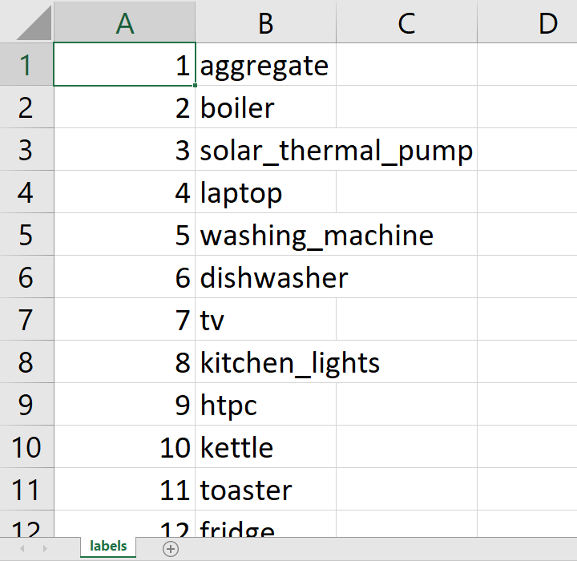
Dataset explanation
House#1
House#2
House#3
House#4
House#5
house_1/labels.csv
53
1
2
3
……………….. 53
Channel Number

Slide 10
Dataset explanation
House#1
house_1/labels.csv
53
1
2
3
……………….. 53

Slide 11
Dataset explanation
House#1
house_1/labels.csv
‘Aggregate’
Or Channel 1 is
The Load of the whole house
53
1
2
3
……………….. 53
Channel
IDs
Channel
ID
Appliance
Name

Slide 12
Dataset explanation
House#1
house_1/labels.csv
53
1
2
3
……………….. 53
‘Boiler’

Slide 13
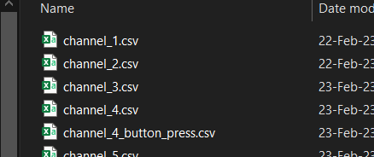
Dataset explanation
House#1
53
1
2
3
……………….. 53
house_1/
‘Boiler’

Slide 14
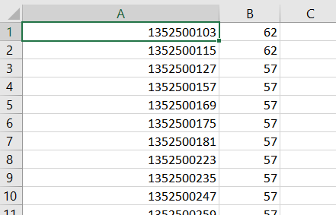
Dataset explanation
(Unit of watts)
UNIX
Timestamp
Power Demand of Load
house_1/

Slide 15
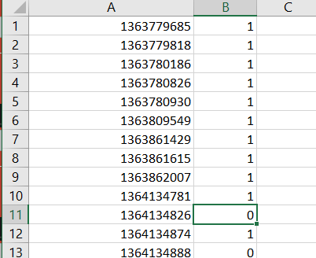
Dataset explanation
UNIX
Timestamp
On/Off Switch Press Indicator
house_1/

Slide 16
Dataset explanation
Input Features
X
Output features
Y
(House#, Channel#, Timestamp)
(Power Demand)
Example: For X = (House 1, Channel 2, 1352500103)
Y = 62 Watt

Slide 17
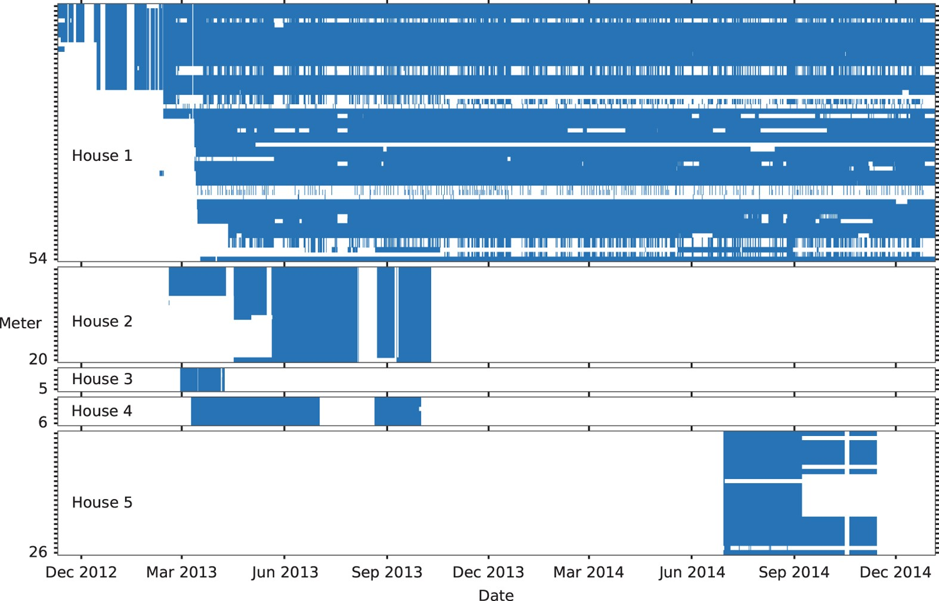
Data exploration stats
We do have missing values, and the data recordings were not contiguous every time. (White hollow parts in between blue parts)
Fig: Time periods when meters were recording [Ref1]

Slide 18
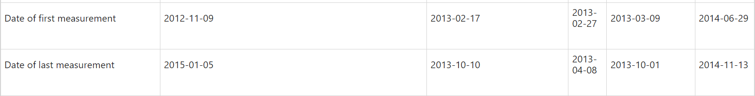
Data exploration stats
Table: Start and End Time of Recording in Each House [Ref1]
[UKDALE 2015th Version]

Slide 19
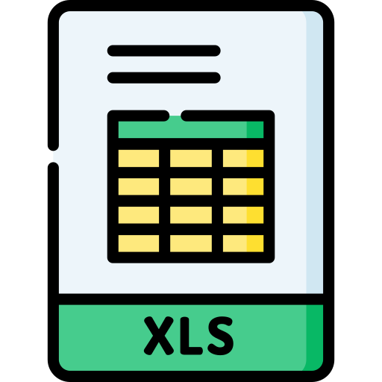
Feature explanation
House# Numerical -The one of the five houses of the dataset.
Channel# Numerical - The channel number that is mapped in the ‘labels.csv file with its appliance name.’
Timestamp Numerical - The UNIX timestamp of the recorded power demand.
PowerDemand Numerical - The power demand of the load at a timestamp a channel inside the house.
1.
2.
3.
4.

Slide 20



What kind of ML system is it?
Supervised
forecasting
Batch learning
For every input feature
$(House\#, Appliance\#, Time)$ there is a load value given in the Dataset.
We will forecast load consumption value, so it is a different problem than regression & classification.
Although it is possible to create online learning though different models, our initial ML system will be in batch mode.

Slide 21


Expected possible outcomes
1.
Paper publication
On Electricity Load Consumption Forecasting and
Electricity + Security problem!
2.
End-to-end solution
Predict House Electricity Load Consumption: User Selects which one of the five house’s demography &/or appliances numbers best fits their home and forecast a consumption for the near future.

Slide 22

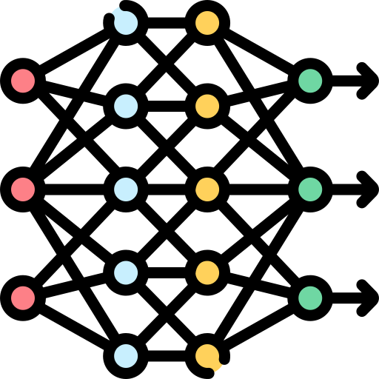


Technology stack & viable models
1.
3.
Tech STACK:
DL models:
Python, NumPy, Seaborn, Scikit Learn, PyTorch.
Also: Flask backend, ReactJS frontend.
RNNs (e.g. LSTM)
CNNs
2.
ML Models:
ARIMA, Auto ARIMA, Seasonal Arima Models, Exponential Smoothing Models, XGBoosts/GBTs

Slide 23
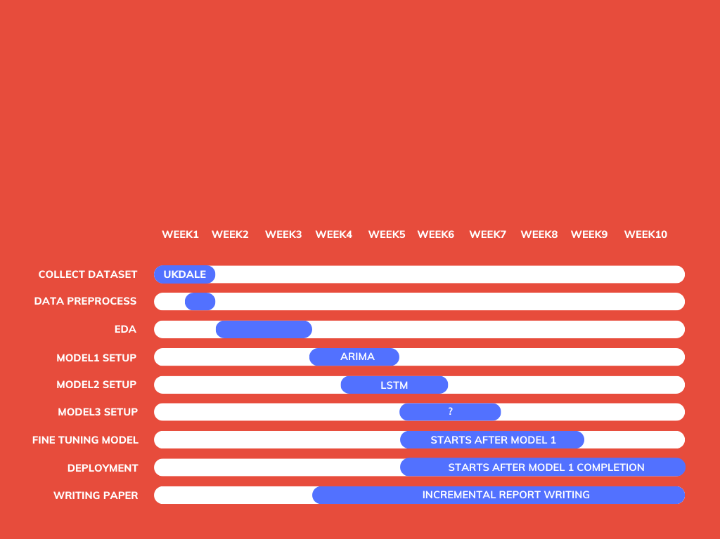
Gannt Chart (tentative)

Slide 24

THANK YOU
Shaiara Tabassum | Mosroor Mofiz Arman | Md Sahadul Hasan Arian

Slide 25
references
DATASET PAPER
Images & icons
Kelly, J., Knottenbelt, W. The UK-DALE dataset, domestic appliance-level electricity demand and whole-house demand from five UK homes. Sci Data 2, 150007 (2015).
Flaticon.com
Freepik.com

